Slide 1
System-User Prompt Design

Slide 2
System-User Prompt Design
One way to increase the performance of the model is to use System-User Prompt structure.
In this way, the system prompt is constructed around defining the task and what model should generate.
The user prompt is considered as the prompt given by the user.
The system prompt is mostly unchanged throughout the iterations and user prompt is always dynamic.

Slide 3
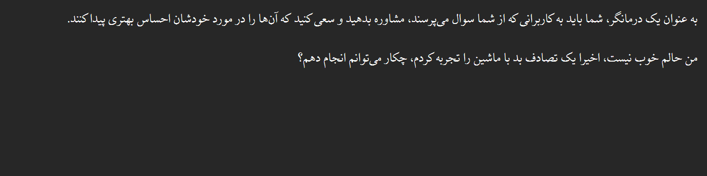
System-User Prompt Design
The input prompt which is only in Persian language:
Without the use of any system-user prompt instruction.

Slide 4
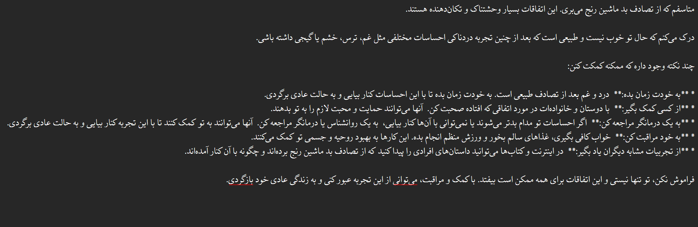
System-User Prompt Design
And this is the result form Gemma2 9b it:
Which is quite acceptable

Slide 5
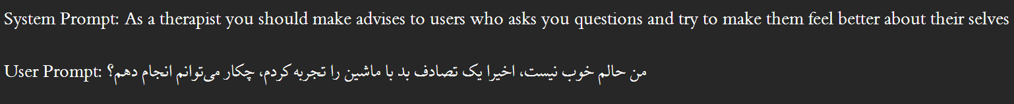
System-User Prompt Design
Now we changed the input prompt to have system-user instruction.
In a way that System prompt being in English language and the user prompt being in Persian language.
This is due to the reason that the model can understand instructions better in English language and have a better reasoning in that situation.

Slide 6
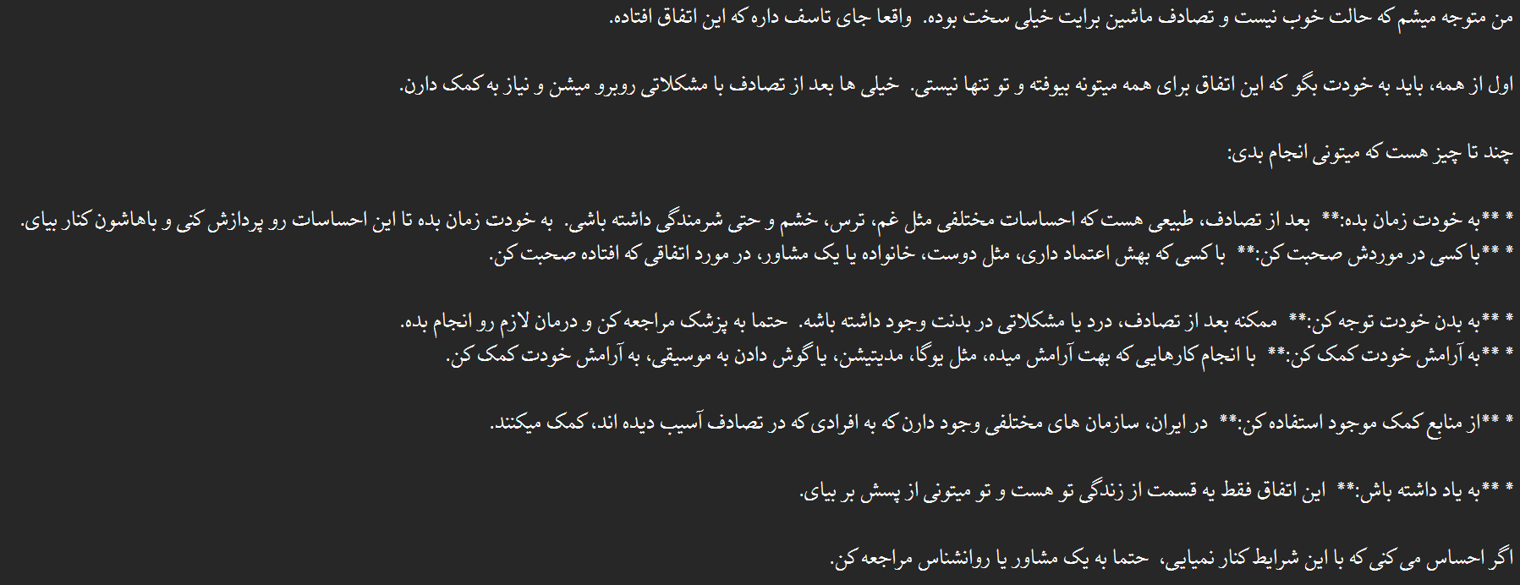
System-User Prompt Design
This the result form Gemma2 9b it for changed prompt:
Not only the reference time was 2x faster, but also the results became more natural and enhanced.

Slide 7
System-User Prompt Design
As the result of the little experience conducted, it is worthwhile to test the system-user prompt design with system prompt being in English (including the k-shot examples in Farsi) and the user prompt being the same.
In that case it is feasible to not repeat the instructions due to the better understanding of the model.

Slide 8
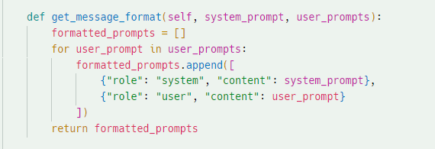
System-User Prompt Results
Now for this part, we changed the code in a way that accepts both roles of ‘user’ and ‘system’.
It should be mentioned that gemma2 doesn’t support any other role than ‘user’.

Slide 9
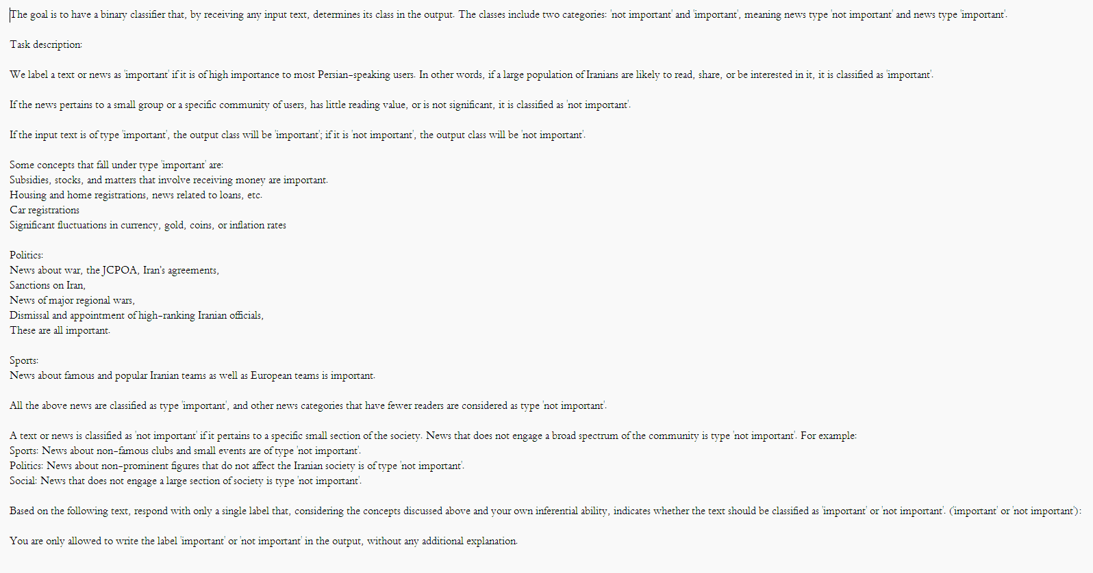
System-User Prompt Results
Moreover, we changed the system prompt to English and maintained the input and samples in Persian.

Slide 10
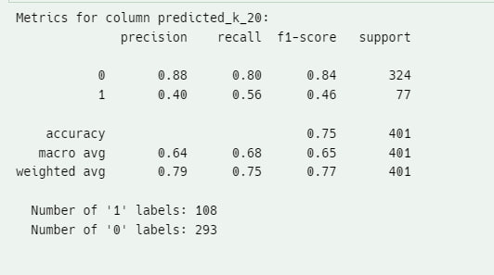
System-User Prompt Results
The shown figure illustrates the result for the first 400 samples with k=20 shot learning and in only title mode.
Here the ‘important’ and ‘not important’ labels are used.

Slide 11
System-User Prompt Results
In conclusion, it seems that both ‘system-user’ prompt design and using English system prompt result in better performance.
It is highly possible that the model has better reasoning power in English rather than Persian.

Slide 12
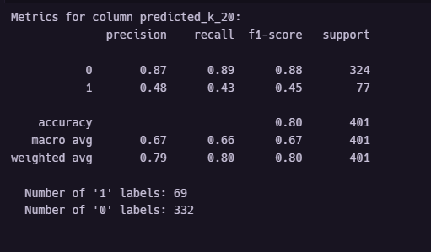
System-User Prompt Results
In further step, we changed the labels to ‘0’ and ‘1’s and here is the results.
As we can see there are fewer ‘1’ label predicted hence the overall f1-score saw an increase.

Slide 13
System-User Prompt Results
Changing labels from ‘important’ and ‘not important’ to ‘1’s and ‘0’s result it 2% of increase in accuracy.
The main reason is that in second situation, the model predicted less ‘1’ labels.
Still, it is arguable what the real reason is behind predicting less ‘1’ labels and why in this case LLM would interpret the prompt in a different way.

Slide 14
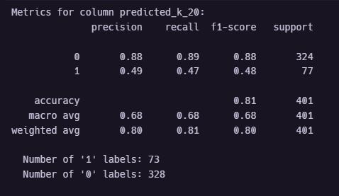
System-User Prompt Results
In next step, we remove the description related to ‘not important’ news. This result in 1% of increase in f1-score.
The better result could be because of less additional information in the prompt.

Slide 15
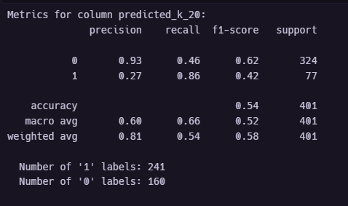
System-User Prompt Results
Now we tested Persian system prompt, as we can see the f1-score is 16% less than the English prompt.
This clearly depicts the fact that LLMs have better reasoning performance in English rather than Farsi.

Slide 16
System-User Prompt Results
Now we tested Persian system prompt, as we can see the f1-score is 16% less than the English prompt.
This clearly depicts the fact that LLMs have better reasoning performance in English rather than Farsi.

Slide 17
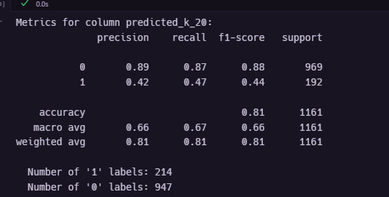
System-User Prompt Results
The result of English system prompt in all test data.

Slide 18
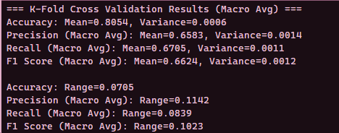
System-User Prompt Results
The Variance in different kfold:

Slide 19
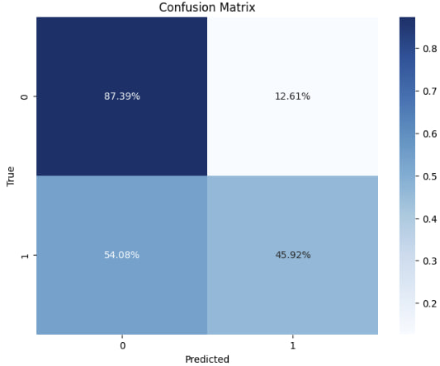
System-User Prompt Results
The confusion matrix for best result:

Slide 20
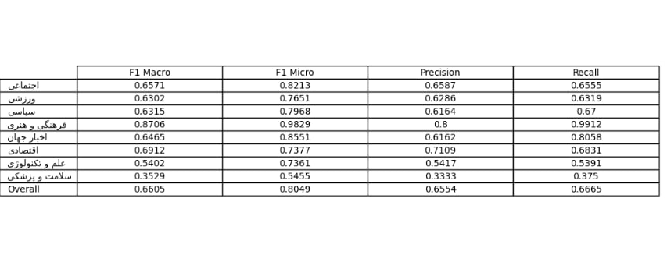
System-User Prompt Results
The f1-score across different categorize:

Slide 21
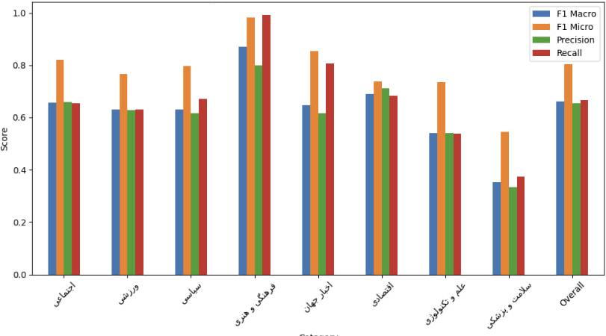
System-User Prompt Results
The bar chart across different categorize:

Slide 22
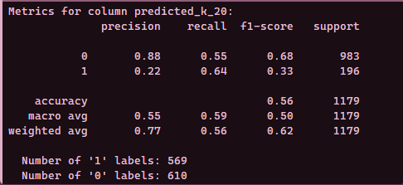
System-User Prompt Results
The result of English system prompt in all test data for full text:
It seems that the user prompt in full text hindered the accuracy in a noticeable way.

Slide 23
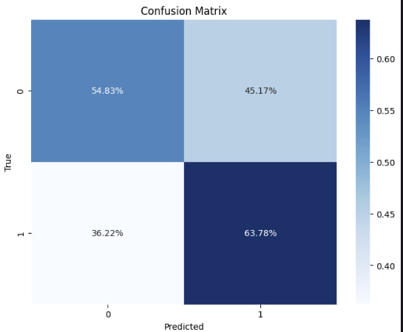
System-User Prompt Results
The confusion matrix for full text:

Slide 24
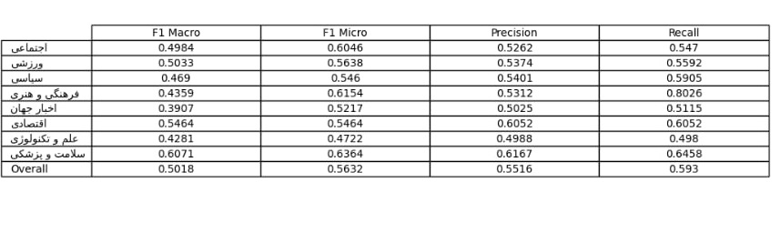
System-User Prompt Results
F1-score across different categories for the full text condition:

Slide 25
Categorized System-User Prompt
Now we aim to have different system prompts for different category of news.
This may result in more accuracy in specific scenarios.
For this reason, we designed sport system prompt
Included more related points to the important sport news
Remained the structure of the previous prompt.

Slide 26
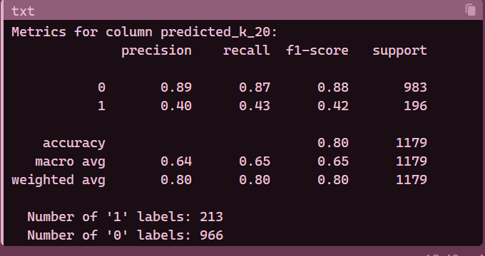
Sport System Prompt Results
We can see the overall sport system prompt result here:

Slide 27
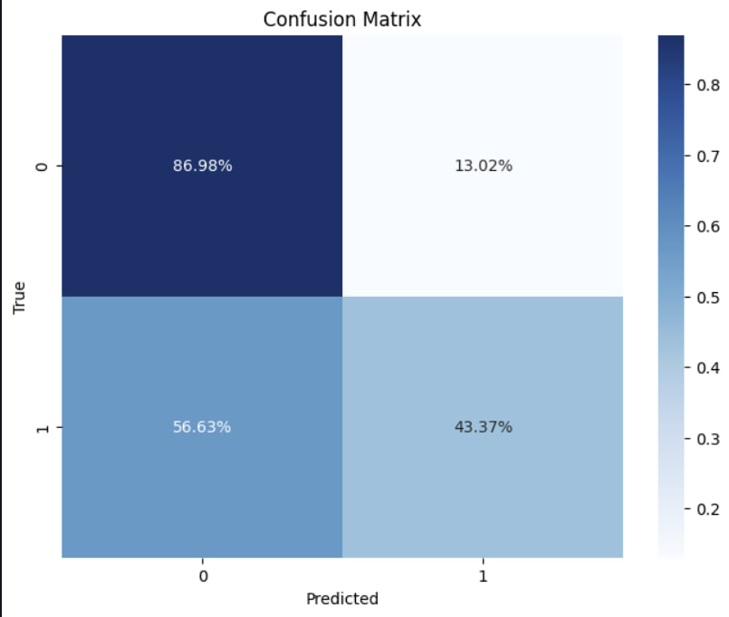
Sport System Prompt Results
The confusion matrix for it:
As it is observable, the ‘1’ class has a 50/50 prediction.

Slide 28
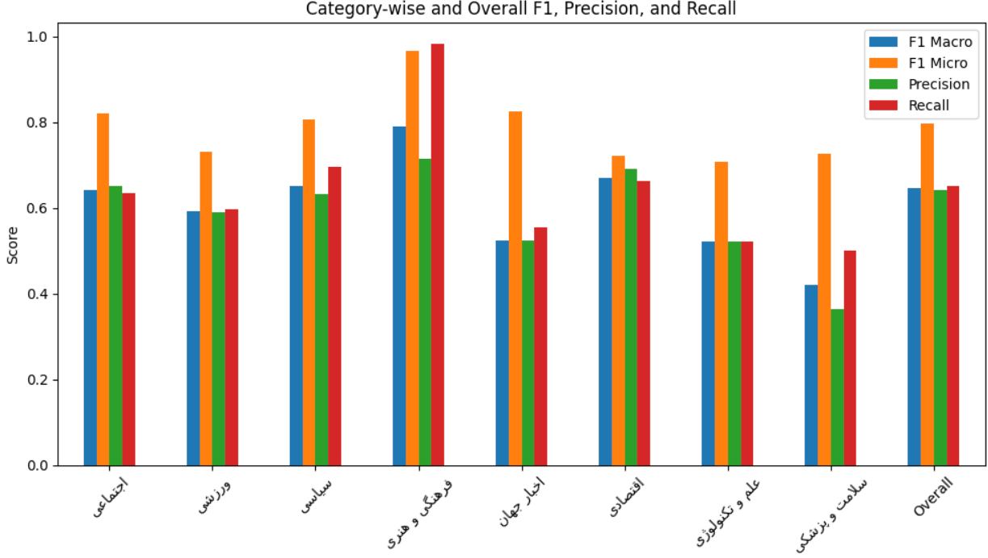
Sport System Prompt Results
And the accuracy across different categorize:

